Slide 1
Topic 2: Combinational Logic Circuit
Analysis and design of combinational logic circuit
Hazard

Slide 2
Combinational Circuits
Output is function of input only
  i.e. no feedback i.e. no memory
  When input changes, output may change (after a delay)
Combinational
Circuits
n inputs
m outputs
•
•
•
•
•
•
✗
<number> / 65
Notes:
Princess Sumaya University
4241 - Digital Logic Design
Dr. Bassam Kahhaleh

Slide 3
Combinational Circuits
Example:
XMUM announces a new crash course on Electronics. A student can take the course if only the following conditions are satisfied:
Completed at least 60 credit hour and Engineering student with good results.
Completed at least 60 credit hour, an engineering student and has departmental permission.
Completed less than 60 credit hour and engineering student with bad results
Good results and has departmental permission
Engineering student with no departmental approval
<number> / 65
Notes:
Princess Sumaya University
4241 - Digital Logic Design
Dr. Bassam Kahhaleh

Slide 4
Combinational Circuits
Lets consider the case:
A= Completed at least 60 credit hour
B= Engineering Student
C= Good results
D= Departmental approval
Z= Student can take the course
A means true and A’ means not true
Z= ABC+ABD+A’BC’+CD+BD’
<number> / 65
Notes:
Princess Sumaya University
4241 - Digital Logic Design
Dr. Bassam Kahhaleh

Slide 5
Combinational Circuits
Z= B+CD
Simply, the decision is a student can take the course:
If he is an Engineering student
Or, he has good results and departmental permission.
<number> / 65
Notes:
Princess Sumaya University
4241 - Digital Logic Design
Dr. Bassam Kahhaleh

Slide 6
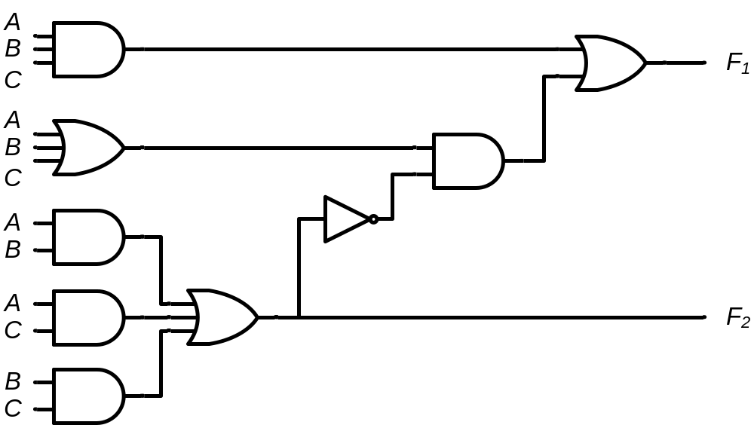
Combinational Circuits
Analysis
  Given a circuit, find out its function
  Function may be expressed as:
    Boolean function
    Truth table
Design
  Given a desired function, determine its circuit
  Function may be expressed as:
    Boolean function
    Truth table
?
?
?
<number> / 65
Notes:
Princess Sumaya University
4241 - Digital Logic Design
Dr. Bassam Kahhaleh

Slide 7
Analysis Procedure
Boolean Expression Approach
T₂=ABC
T₁=A+B+C
T₃=AB'C'+A'BC'+A'B'C
F’₂=(A’+B’)(A’+C’)(B’+C’)
F₂=AB+AC+BC
F₁=AB'C'+A'BC'+A'B'C+ABC
F₂=AB+AC+BC
<number> / 65
Notes:
Princess Sumaya University
4241 - Digital Logic Design
Dr. Bassam Kahhaleh

Slide 8
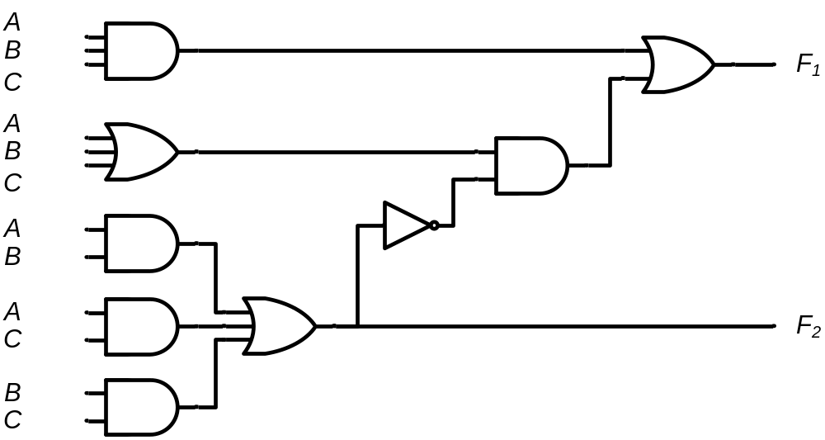
Analysis Procedure
Truth Table Approach
A B C | F₁ | F₂
0 0 0
= 0
= 0
= 0
= 0
= 0
= 0
= 0
= 0
= 0
= 0
= 0
= 0
0 0
0
0
0
0
0
0
0
1
0
<number> / 65
Notes:
Princess Sumaya University
4241 - Digital Logic Design
Dr. Bassam Kahhaleh

Slide 9
Analysis Procedure
Truth Table Approach
A B C | F₁ | F₂
0 0 0 | 0 | 0
0 0 1
= 0
= 0
= 1
= 0
= 0
= 1
= 0
= 0
= 0
= 1
= 0
= 1
0
1
0
0
0
1
1 0
1
1
0
<number> / 65
Notes:
Princess Sumaya University
4241 - Digital Logic Design
Dr. Bassam Kahhaleh

Slide 10
Analysis Procedure
Truth Table Approach
A B C | F₁ | F₂
0 0 0 | 0 | 0
0 0 1 | 1 | 0
0 1 0
= 0
= 1
= 0
= 0
= 1
= 0
= 0
= 1
= 0
= 0
= 1
= 0
0
1
0
0
0
1
1 0
1
1
0
<number> / 65
Notes:
Princess Sumaya University
4241 - Digital Logic Design
Dr. Bassam Kahhaleh

Slide 11
Analysis Procedure
Truth Table Approach
A B C | F₁ | F₂
0 0 0 | 0 | 0
0 0 1 | 1 | 0
0 1 0 | 1 | 0
0 1 1
= 0
= 1
= 1
= 0
= 1
= 1
= 0
= 1
= 0
= 1
= 1
= 1
0
1
0
0
1
0
0
0 1
0
1
<number> / 65
Notes:
Princess Sumaya University
4241 - Digital Logic Design
Dr. Bassam Kahhaleh

Slide 12
Analysis Procedure
Truth Table Approach
A B C | F₁ | F₂
0 0 0 | 0 | 0
0 0 1 | 1 | 0
0 1 0 | 1 | 0
0 1 1 | 0 | 1
1 0 0
= 1
= 0
= 0
= 1
= 0
= 0
= 1
= 0
= 1
= 0
= 0
= 0
0
1
0
0
0
1
1
1
1 0
0
<number> / 65
Notes:
Princess Sumaya University
4241 - Digital Logic Design
Dr. Bassam Kahhaleh

Slide 13
Analysis Procedure
Truth Table Approach
A B C | F₁ | F₂
0 0 0 | 0 | 0
0 0 1 | 1 | 0
0 1 0 | 1 | 0
0 1 1 | 0 | 1
1 0 0 | 1 | 0
1 0 1
= 1
= 0
= 1
= 1
= 0
= 1
= 1
= 0
= 1
= 1
= 0
= 1
0
1
0
1
0
0
0
0
0 1
1
<number> / 65
Notes:
Princess Sumaya University
4241 - Digital Logic Design
Dr. Bassam Kahhaleh

Slide 14
Analysis Procedure
Truth Table Approach
A B C | F₁ | F₂
0 0 0 | 0 | 0
0 0 1 | 1 | 0
0 1 0 | 1 | 0
0 1 1 | 0 | 1
1 0 0 | 1 | 0
1 0 1 | 0 | 1
1 1 0
= 1
= 1
= 0
= 1
= 1
= 0
= 1
= 1
= 1
= 0
= 1
= 0
0
1
1
0
0
0
0
0
0 1
1
<number> / 65
Notes:
Princess Sumaya University
4241 - Digital Logic Design
Dr. Bassam Kahhaleh

Slide 15
Analysis Procedure
Truth Table Approach
A B C | F₁ | F₂
0 0 0 | 0 | 0
0 0 1 | 1 | 0
0 1 0 | 1 | 0
0 1 1 | 0 | 1
1 0 0 | 1 | 0
1 0 1 | 0 | 1
1 1 0 | 0 | 1
1 1 1
= 1
= 1
= 1
= 1
= 1
= 1
= 1
= 1
= 1
= 1
= 1
= 1
1
1
1
1
1
1
0
0
1
1 1
 |  |  |  | B
 |  | 0 | 1 | 0 | 1
A |  | 1 | 0 | 1 | 0
 |  |  | C
 |  |  |  | B
 |  | 0 | 0 | 1 | 0
A |  | 0 | 1 | 1 | 1
 |  |  | C
F₁=AB'C'+A'BC'+A'B'C+ABC
F₂=AB+AC+BC
<number> / 65
Notes:
Princess Sumaya University
4241 - Digital Logic Design
Dr. Bassam Kahhaleh

Slide 16
Design Procedure
Given a problem statement:
  Determine the number of inputs and outputs
  Derive the truth table
  Simplify the Boolean expression for each output
  Produce the required circuit
Example:
Design a circuit to convert a “BCD” code to “Excess 3” code
4-bits
0-9 values
?
4-bits
Value+3
<number> / 65
Notes:
Princess Sumaya University
4241 - Digital Logic Design
Dr. Bassam Kahhaleh

Slide 17
Design Procedure
BCD-to-Excess 3 Converter
 |  |  |  | C
 |  |  | 1 | 1 | 1 | B
A |  | x | x | x | x
 |  | 1 | 1 | x | x
 |  |  | D
 |  |  |  | C
 |  |  | 1 | 1 | 1
 |  | 1 |  |  |  | B
A |  | x | x | x | x
 |  |  | 1 | x | x
 |  |  | D
A B C D | w x y z
0 0 0 0 | 0 0 1 1
0 0 0 1 | 0 1 0 0
0 0 1 0 | 0 1 0 1
0 0 1 1 | 0 1 1 0
0 1 0 0 | 0 1 1 1
0 1 0 1 | 1 0 0 0
0 1 1 0 | 1 0 0 1
0 1 1 1 | 1 0 1 0
1 0 0 0 | 1 0 1 1
1 0 0 1 | 1 1 0 0
1 0 1 0 | x x x x
1 0 1 1 | x x x x
1 1 0 0 | x x x x
1 1 0 1 | x x x x
1 1 1 0 | x x x x
1 1 1 1 | x x x x
w = A+BC+BD
x = B’C+B’D+BC’D’
 |  |  |  | C
 |  | 1 |  | 1
 |  | 1 |  | 1 |  | B
A |  | x | x | x | x
 |  | 1 |  | x | x
 |  |  | D
 |  |  |  | C
 |  | 1 |  |  | 1
 |  | 1 |  |  | 1 | B
A |  | x | x | x | x
 |  | 1 |  | x | x
 |  |  | D
y = C’D’+CD
z = D’
<number> / 65
Notes:
Princess Sumaya University
4241 - Digital Logic Design
Dr. Bassam Kahhaleh

Slide 18
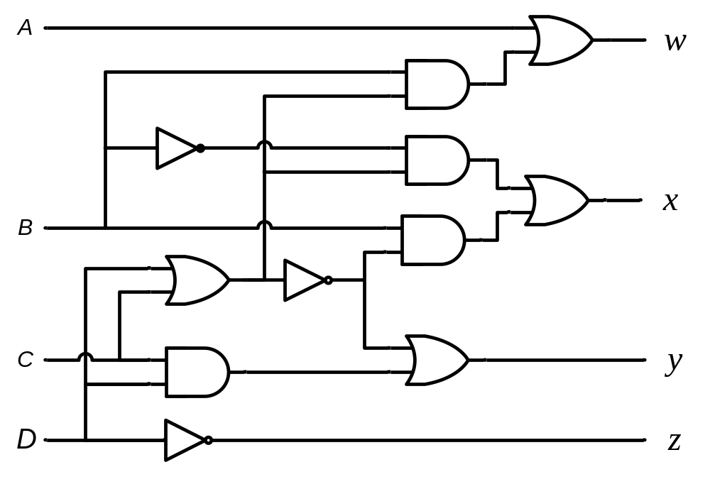
Design Procedure
BCD-to-Excess 3 Converter
A B C D | w x y z
0 0 0 0 | 0 0 1 1
0 0 0 1 | 0 1 0 0
0 0 1 0 | 0 1 0 1
0 0 1 1 | 0 1 1 0
0 1 0 0 | 0 1 1 1
0 1 0 1 | 1 0 0 0
0 1 1 0 | 1 0 0 1
0 1 1 1 | 1 0 1 0
1 0 0 0 | 1 0 1 1
1 0 0 1 | 1 1 0 0
1 0 1 0 | x x x x
1 0 1 1 | x x x x
1 1 0 0 | x x x x
1 1 0 1 | x x x x
1 1 1 0 | x x x x
1 1 1 1 | x x x x
w = A + B(C+D)
y = (C+D)’ + CD
x = B’(C+D) + B(C+D)’
z = D’
<number> / 65
Notes:
Princess Sumaya University
4241 - Digital Logic Design
Dr. Bassam Kahhaleh

Slide 19

Seven-Segment Decoder
a
w x y z | a b c d e f g
0 0 0 0 | 1 1 1 1 1 1 0
0 0 0 1 | 0 1 1 0 0 0 0
0 0 1 0 | 1 1 0 1 1 0 1
0 0 1 1 | 1 1 1 1 0 0 1
0 1 0 0 | 0 1 1 0 0 1 1
0 1 0 1 | 1 0 1 1 0 1 1
0 1 1 0 | 1 0 1 1 1 1 1
0 1 1 1 | 1 1 1 0 0 0 0
1 0 0 0 | 1 1 1 1 1 1 1
1 0 0 1 | 1 1 1 1 0 1 1
1 0 1 0 | x x x x x x x
1 0 1 1 | x x x x x x x
1 1 0 0 | x x x x x x x
1 1 0 1 | x x x x x x x
1 1 1 0 | x x x x x x x
1 1 1 1 | x x x x x x x
w
x
y
z
a
b
c
d
e
f
g
f
b
?
g
e
c
BCD code
d
 |  |  |  | y
 |  | 1 |  | 1 | 1
 |  |  | 1 | 1 | 1 | x
w |  | x | x | x | x
 |  | 1 | 1 | x | x
 |  |  | z
a = w + y + xz + x’z’
b = . . .
c = . . .
d = . . .
<number> / 65
Notes:
Princess Sumaya University
4241 - Digital Logic Design
Dr. Bassam Kahhaleh

Slide 20
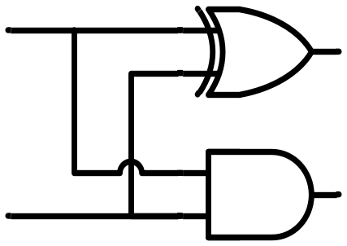


Binary Adder
Half Adder
  Adds 1-bit plus 1-bit
  Produces Sum and Carry
x
+ y
───
C S
x
y
S
C
HA
x y | C S
0 0 | 0 0
0 1 | 0 1
1 0 | 0 1
1 1 | 1 0
x
y
S
C
<number> / 65
Notes:
Princess Sumaya University
4241 - Digital Logic Design
Dr. Bassam Kahhaleh

Slide 21
Binary Adder
x
+ y
+ z
───
C S
Full Adder
  Adds 1-bit plus 1-bit plus 1-bit
  Produces Sum and Carry
x
y
z
S
C
FA
 |  |  |  | y
 |  | 0 | 1 | 0 | 1
x |  | 1 | 0 | 1 | 0
 |  |  | z
x y z | C S
0 0 0 | 0 0
0 0 1 | 0 1
0 1 0 | 0 1
0 1 1 | 1 0
1 0 0 | 0 1
1 0 1 | 1 0
1 1 0 | 1 0
1 1 1 | 1 1
S = xy'z'+x'yz'+x'y'z+xyz = x ⊕ y ⊕ z
 |  |  |  | y
 |  | 0 | 0 | 1 | 0
x |  | 0 | 1 | 1 | 1
 |  |  | z
C = xy + xz + yz
<number> / 65
Notes:
Princess Sumaya University
4241 - Digital Logic Design
Dr. Bassam Kahhaleh

Slide 22
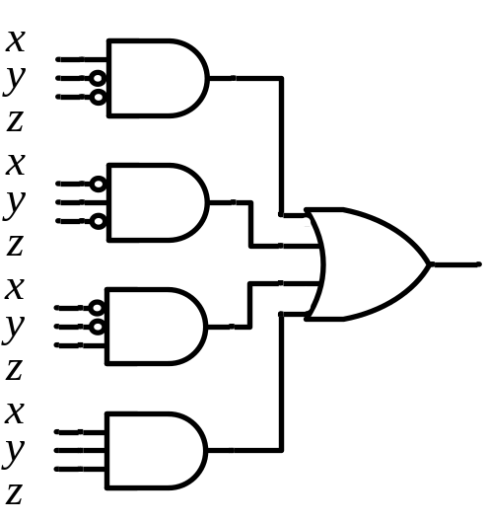
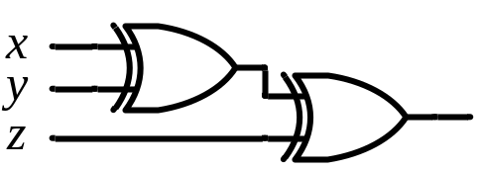
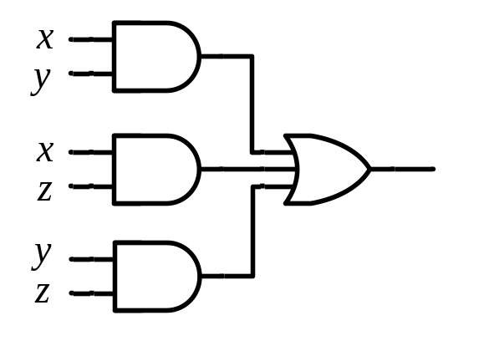
Binary Adder
Full Adder
S = xy'z'+x'yz'+x'y'z+xyz = x ⊕ y ⊕ z
C = xy + xz + yz
x
y
z
S
C
S
C
x
y
z
<number> / 65
Notes:
Princess Sumaya University
4241 - Digital Logic Design
Dr. Bassam Kahhaleh

Slide 23

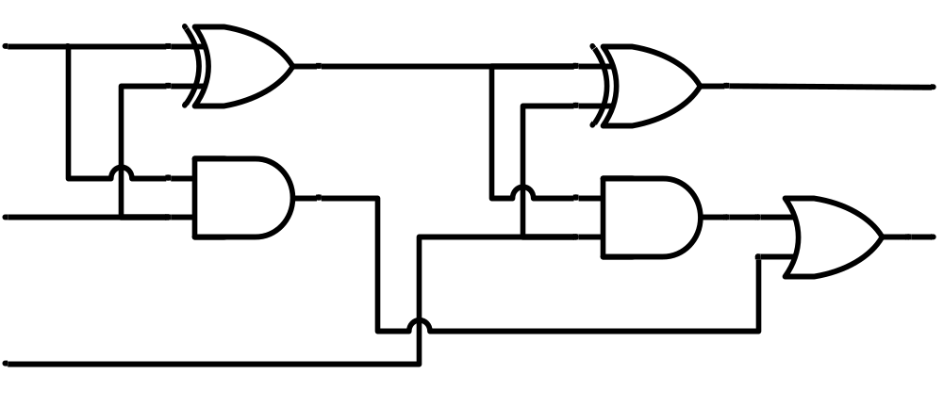
Binary Adder
Full Adder
HA
HA
x
y
z
S
C
x
y
z
S
C
<number> / 65
Notes:
Princess Sumaya University
4241 - Digital Logic Design
Dr. Bassam Kahhaleh

Slide 24
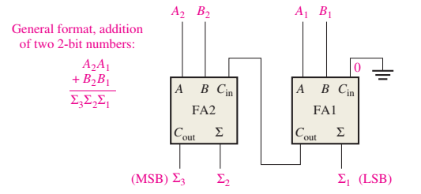
Binary Parallel Adder
A single full-adder is capable of adding two 1-bit numbers and an input carry.
To add binary numbers with more than one bit, additional full-adders are needed.
When one binary number is added to another, each column generates a sum bit and a 1 or 0 carry bit to the next column to the left, as illustrated here with 2-bit numbers.
<number> / 65
Notes:
Princess Sumaya University
4241 - Digital Logic Design
Dr. Bassam Kahhaleh

Slide 25
4 bit Binary Parallel Adder
x₃x₂x₁x₀ y₃y₂y₁y₀
c₃ c₂ c₁ .
+ x₃ x₂ x₁ x₀
+ y₃ y₂ y₁ y₀
────────
Cy S₃ S₂ S₁ S₀
Binary Adder
Carry Propagate Addition
C_{y}
C₀
S₃S₂S₁S₀
x₃ x₂ x₁ x₀
y₃ y₂ y₁ y₀
0
FA
FA
FA
FA
C₄ C₃ C₂ C₁
S₃ S₂ S₁ S₀
<number> / 65
Notes:
Princess Sumaya University
4241 - Digital Logic Design
Dr. Bassam Kahhaleh

Slide 26
Binary Adder Expansion
Carry Propagate Adder
x₇ x₆ x₅ x₄
x₃ x₂ x₁ x₀
y₇ y₆ y₅ y₄
y₃ y₂ y₁ y₀
CPA
CPA
A₃ A₂ A₁ A₀
B₃ B₂ B₁ B₀
A₃ A₂ A₁ A₀
B₃ B₂ B₁ B₀
C_{y}
C₀
C_{y}
C₀
0
S₃ S₂ S₁ S₀
S₃ S₂ S₁ S₀
S₇ S₆ S₅ S₄
S₃ S₂ S₁ S₀
<number> / 65
Notes:
Princess Sumaya University
4241 - Digital Logic Design
Dr. Bassam Kahhaleh

Slide 27
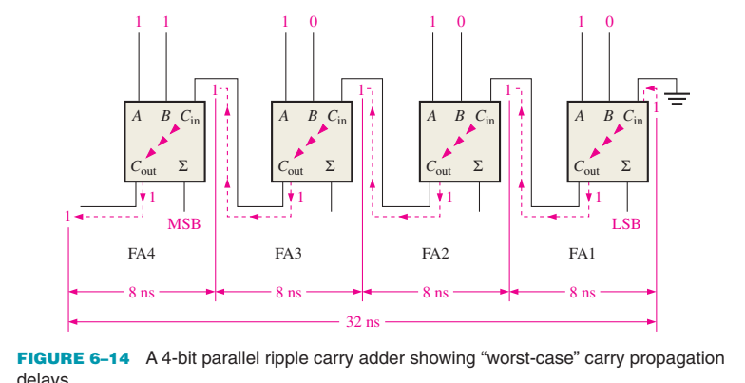
Carry propagation
  The sum and the output carry of any stage cannot be produced until the input carry occurs; this causes a time delay in the addition process,
  (A₁, B₁, C₁) → C₂ → C₃ → C₄ → (C₅, S₄)
<number> / 65
Notes:
Princess Sumaya University
4241 - Digital Logic Design
Dr. Bassam Kahhaleh

Slide 28

Any Questions

